Slide 1

Capstone Project 3:
Cardiovascular Disease Predictions
Team members:
Rohan Dhunde

Slide 2
Index
Problem description
Business understanding
Exploratory data analysis(EDA)
Feature engineering &data preprocessing
Dimensionality reduction
Handling imbalance data set
model 1
model 2
Conclusion

Slide 3
Problem Discreption
Cardiovascular diseases are a leading cause of mortality and morbidity worldwide. The problem statement for cardiovascular diseases involves understanding the risk factors, causes, and consequences of these diseases, as well as developing effective prevention, diagnosis, and treatment strategies. The goal is to reduce the incidence and impact of cardiovascular diseases on individuals, communities, and healthcare systems, and to improve overall cardiovascular health and well-being.

Slide 4
Business Understanding
From a business perspective, cardiovascular disease represents a significant market opportunity for pharmaceutical and medical device companies. The market for cardiovascular disease treatments is expected to continue to grow as the global population ages and the incidence of risk factors such as obesity and diabetes increases.
The global cardiovascular disease market includes several segments, including drugs, devices, and diagnostic tools. The drugs segment includes several classes of medications, including statins, beta-blockers, ACE inhibitors, and calcium channel blockers. The devices segment includes a range of products, including pacemakers, stents, and implantable cardioverter-defibrillators (ICDs). The diagnostic tools segment includes tests such as electrocardiograms (ECGs) and echocardiograms.
The business of cardiovascular disease is also impacted by the healthcare policies and regulations of individual countries. Reimbursement policies, intellectual property laws, and pricing regulations can all have an impact on the development and commercialization of new cardiovascular disease treatments.

Slide 5
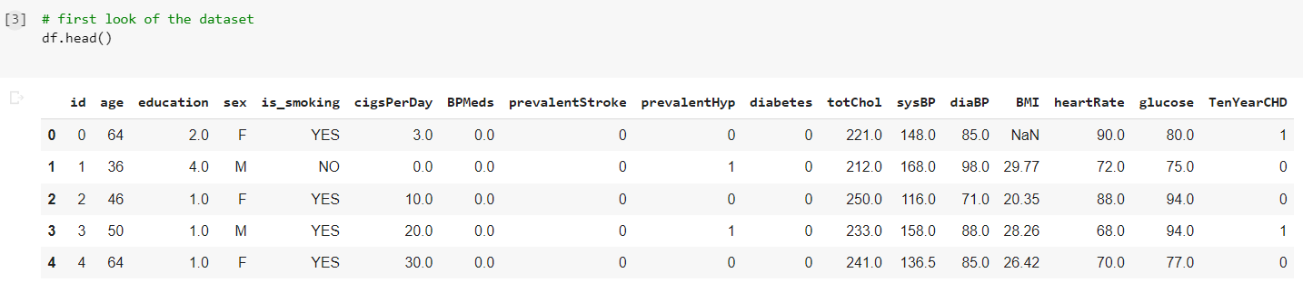
First Look Of The Dataset
This dataset contain 3390 rows and 14 columns
The dataset contain the categorical and also contain the numerical values

Slide 6
Data Summary
the dataset contain the missing values
Dataset not contain any duplicate values
All the data column contain the unique values
The data shows the Ten-year risk of coronary heart disease

Slide 7
Feature Types
Featurs
Numaric | Categorical
age | education
cigsPerDay | sex
totChol | is_smoking
BMI | BPMeds
heartRate | prevalentStroke
glucose | prevalentHyp
 | diabetes
Target Values
TenYearCHD

Slide 8
Feature Summary
id: Unique identifier for each observation.
age: Age of the participant in years.
education: Level of education completed by the participant, with values ranging from 1 (less than high school) to 4 (college graduate).
sex: Gender of the participant, with values of "F" (female) or "M" (male).
is_smoking: Smoking status of the participant, with values of "NO" (not currently smoking) or "YES" (currently smoking).
cigsPerDay: Number of cigarettes smoked per day by the participant.
BPMeds: Whether the participant is taking blood pressure medication, with values of 0 (not taking medication) or 1 (taking medication).
prevalentStroke: Whether the participant has a history of stroke, with values of 0 (no history) or 1 (history of stroke).
prevalentHyp: Whether the participant has a history of hypertension, with values of 0 (no history) or 1 (history of hypertension).
diabetes: Whether the participant has diabetes, with values of 0 (no diabetes) or 1 (diabetes).
totChol: Total cholesterol level in mg/dL.
sysBP: Systolic blood pressure in mmHg.
diaBP: Diastolic blood pressure in mmHg.
BMI: Body mass index, calculated as weight (kg) / height (m)^2.
heartRate: Resting heart rate in beats per minute.
glucose: Fasting blood glucose level in mg/dL.
TenYearCHD: Ten-year risk of coronary heart disease, with values of 0 (low risk) or 1 (high risk).

Slide 9
EDA (Exploratory Data Analysis)
.

Slide 10
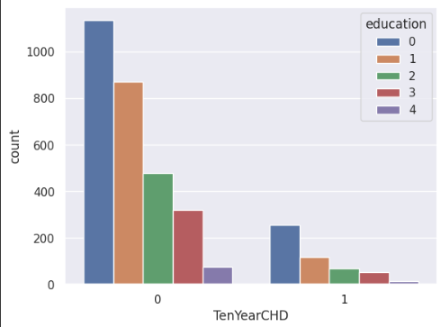
Analysis Education vs TenYearCHD

Slide 11
Analysis Education vs TenYearCHD
The analysis focused on the relationship between education level and the risk of developing coronary heart disease (CHD) within ten years. Here are the key finding:
Impact of Education on TenYearCHD:
The dataset revealed a significant association between education level and the likelihood of developing CHD within ten years.
Individuals with lower education levels had a higher risk of developing CHD compared to those with higher education levels.

Slide 12
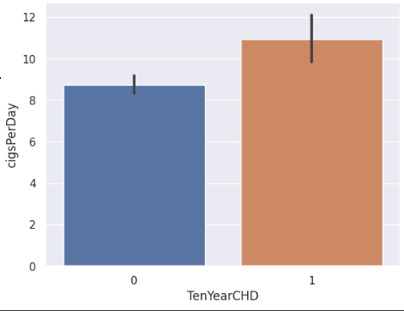
Exploring the relation between the cigsPerDay and TenYearCHD

Slide 13
Exploring the relation between the cigsPerDay and TenYearCHD
Smoking Intensity and CHD Risk:
The analysis investigated the relationship between the number of cigarettes smoked per day (cigsPerDay) and the risk of developing coronary heart disease (CHD) within ten years.
It revealed a clear link between smoking intensity and the risk of CHD, indicating that individuals who smoke more cigarettes per day are at a higher risk of developing CHD.

Slide 14
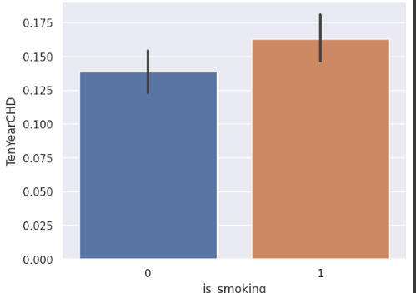
Exploring the the relation Between the is_smoking with TenYearCHD

Slide 15
Exploring the the relation Between the is_smoking with TenYearCHD
Smoking and CHD Risk:
The analysis examined the relationship between the variable "is_smoking" (indicating smoking status) and the risk of developing coronary heart disease (CHD) within ten years.
It found a significant association between smoking and increased risk of CHD, indicating that individuals who smoke are more likely to develop CHD compared to non-smokers.

Slide 16
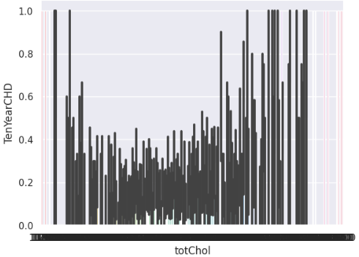
Visualising totChol Vs TenYearCHD

Slide 17
Visualising totChol Vs TenYearCHD
Cholesterol and CHD Risk:
The analysis explored the relationship between the variable "totChol" (total cholesterol levels) and the risk of developing coronary heart disease (CHD) within ten years.
It aimed to understand the impact of cholesterol levels on CHD risk.

Slide 18
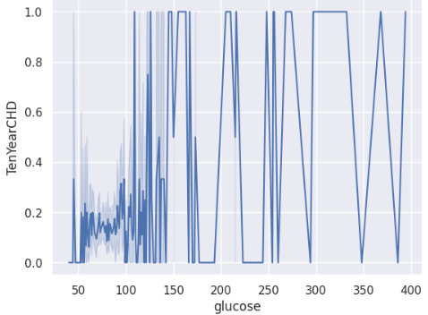
Exploting the relation between the glucose with TenYearCHD

Slide 19
Exploting the relation between the glucose with TenYearCHD
Glucose as a Risk Indicator:
The analysis examined the relationship between the variable "glucose" (blood sugar level) and the presence of coronary heart disease (CHD) within ten years.
The findings indicate that higher glucose levels may be associated with an increased risk of developing CHD.
Impact of Glucose on CHD:
The plot showcases a trend where individuals with elevated glucose levels have a higher likelihood of experiencing CHD compared to those with lower glucose levels.
This suggests that glucose can serve as a potential risk indicator for CHD and may warrant further investigation and monitoring.

Slide 20
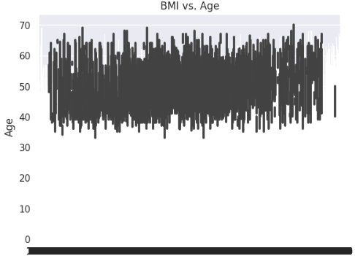
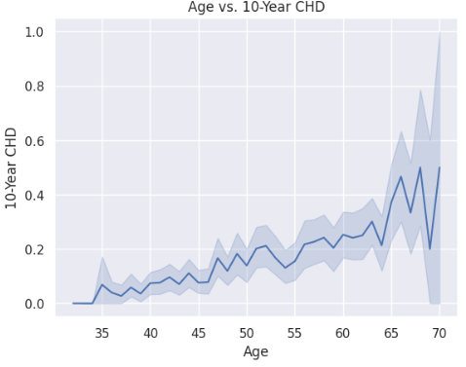
Data Exploring on several columns
The below the plot show the relation between the BMI vs Age, Age vs TenYearCHD

Slide 21
BMI and Age Relationship:
The plot illustrates the relationship between BMI (Body Mass Index) and age.
It showcases how BMI changes across different age groups, providing insights into the
distribution of body weight in the population.
Age and TenYearCHD Relationship:
The plot also presents the relationship between age and TenYearCHD (presence of coronary heart disease within ten years).
It allows for the examination of the incidence of CHD across different age groups, highlighting any patterns or trends.
In summary, the plot visually represents the interplay between BMI, age, and the occurrence of CHD within ten years. By analyzing the plot, we can gain insights into the distribution of BMI across different age groups and observe any potential connections between age and the likelihood of developing CHD. This information can help inform preventive measures and interventions aimed at reducing the risk of CHD in specific age and BMI categories.

Slide 22
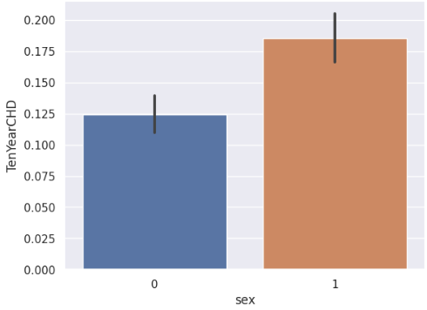
TenYearCHD Vs sex
This plot shows the total numbers of the male and female heving cardiovascular diseases

Slide 23
TenYearCHD Vs sex
Gender Disparity in CHD:
The analysis examined the relationship between the variable "sex" (gender) and the prevalence of coronary heart disease (CHD) within ten years.
The plot clearly illustrates a notable disparity, showing a higher number of males affected by CHD compared to females.

Slide 24
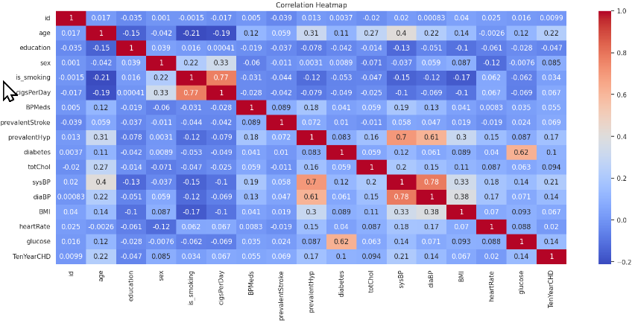
Correlation Heatmap
This plot shoes the correlation of the each plot with each other plot in dataset

Slide 25
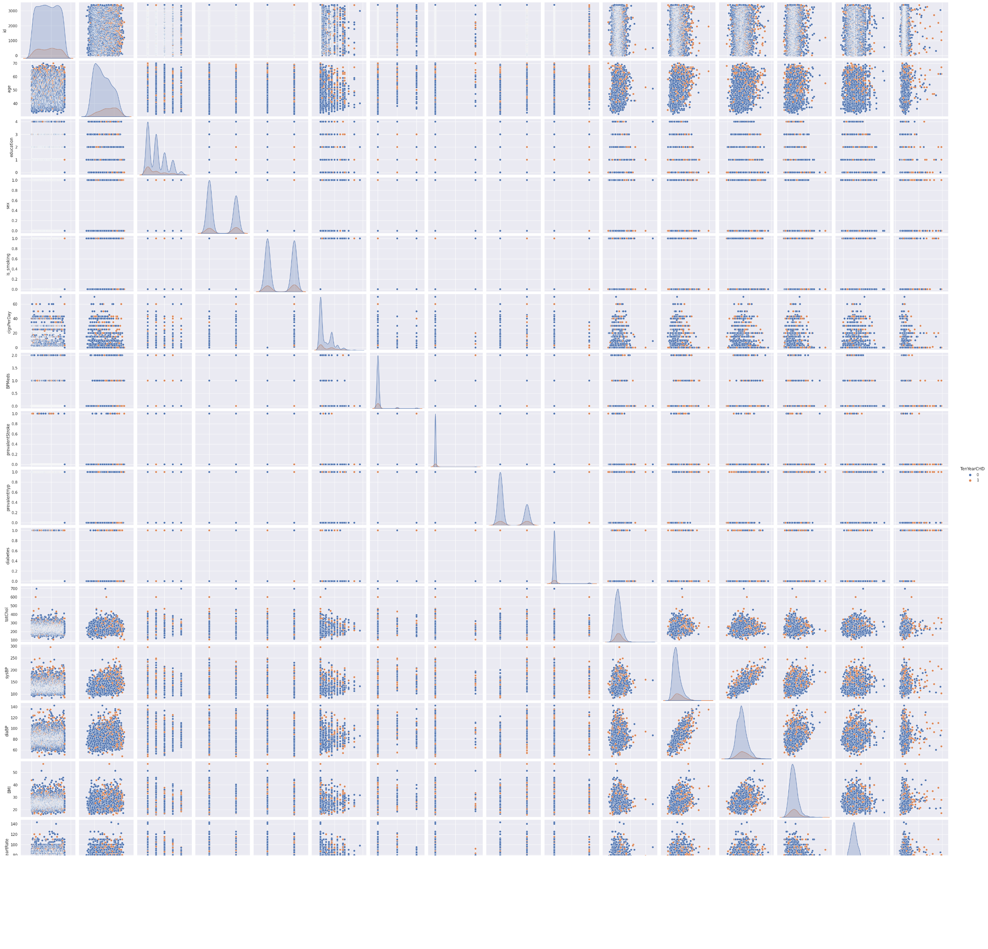
Pair plot
This pair plot shows the distribution of the point for each column with each another columns

Slide 26
Feature Engineering & Data Pre-processing
Handling Missing Values: Handling the missing values with mean
Handling outliers
The use the categorical encoding to transform the categorical data to numerical
Feature selection involves identifying and removing irrelevant or redundant features from a dataset, as well as transforming variables to improve model performance. Then the feature selection in which instantiate target value column and instantiate feature column
Then the part of the data splitting and split the data in train and test set

Slide 27
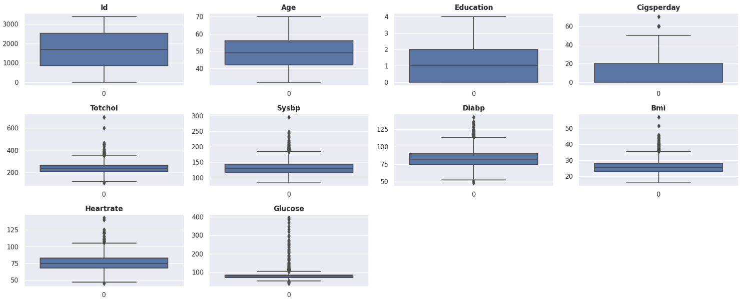
Checking Outliers

Slide 28
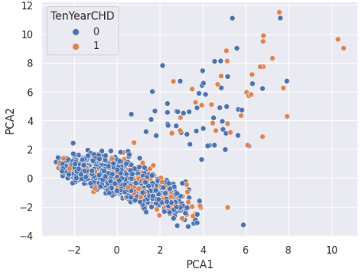
DImensionality Reduction
Using PCA for dimensionality reduction

Slide 29
Prerequisites for Model Building
The data must in numeric format
Data splitting
Dimensionality reduction
Then handling the data imbalance

Slide 30
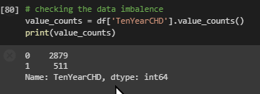
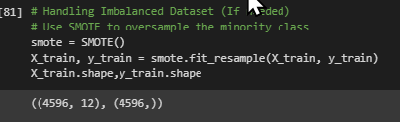
Handling Data imbalance
Before smote
After applying smote

Slide 31
Model 1 :
Logistics Regression :
Logistic regression is a statistical technique used to model the relationship between a categorical dependent variable and one or more independent variables. It is a popular and widely used method for classification problems, such as predicting the likelihood of an event occurring. The logistic regression algorithm calculates the probability of an event occurring based on the values of the input variables. The output of the algorithm is a binary outcome, such as whether a customer will buy a product or not. The logistic regression model can be trained using various optimization techniques, such as gradient descent or Newton's method. It is a simple yet powerful technique that is widely used in various fields, including healthcare, finance, and marketing.

Slide 32
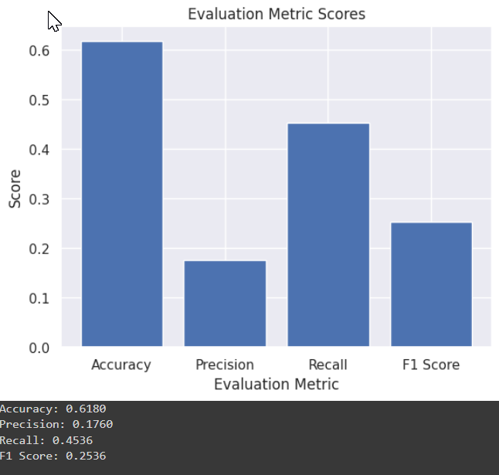
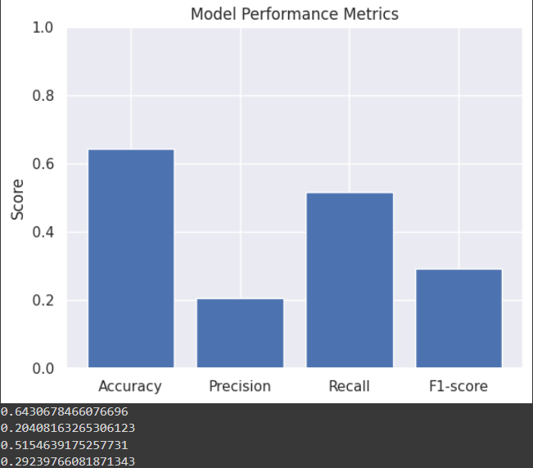
Model Building
Evaluation Metrics Scores in visuals before hyperparameter tunning
Evaluation Metrics Scores in visuals after hyperparameter tunning

Slide 33
Model 1 Performance
The initial logistic regression model had an accuracy of 0.61, precision of 0.17, recall of 0.45, and an F1 score of 0.25.
After tuning the hyperparameters, the logistic regression model's performance improved significantly with an accuracy of 0.64, precision of 0.20, recall of 0.51, and an F1 score of 0.29.
Hyperparameter tuning positively impacted the model's overall performance, particularly in terms of precision and recall, resulting in an increased accuracy and improved ability to correctly identify both positive and negative classes.

Slide 34
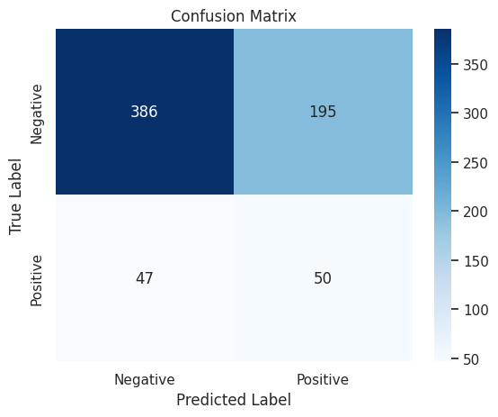
Confusion Metrics

Slide 35
Confusion Metrics
Confusion metrics Explanation:
True positives (TP): 386
False positives (FP): 195
False negatives (FN): 47
True negatives (TN): 50
The confusion matrix suggests that the model has a higher number of false positives than false negatives, indicating that the model is more likely to incorrectly classify negative instances as positive. However, without further context or information about the dataset, it is difficult to assess the overall performance of the model. The precision and recall scores can be calculated using these values to better evaluate the model's performance.

Slide 36
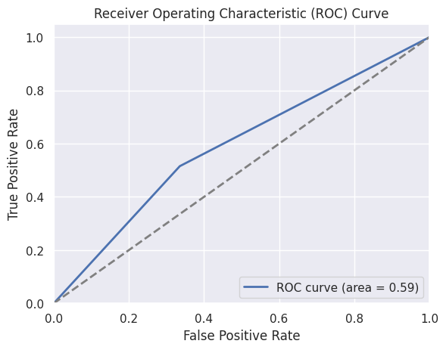
Visualizing ACU and RUC Curves

Slide 37
ACU and RUC Curves
The ROC curve is a graphical representation of the trade-off between sensitivity (true positive rate) and specificity (false positive rate) of a binary classifier at various thresholds. A perfect classifier would have an area under the ROC curve (AUC) of 1.0, while a completely random classifier would have an AUC of 0.5. In this case, the AUC is 0.59, which indicates that the model's performance is only slightly better than random guessing. This suggests that the model may not be accurately capturing the relationship between the features and the target variable, and may require further tuning or additional data to improve its performance.

Slide 38
Model 2:
SVC( Support Vector Classification ):
Support Vector Classification (SVC) is a supervised learning algorithm used for classification tasks in machine learning. SVC works by finding the hyperplane that best separates the data points into different classes. The hyperplane is selected such that the margin between the hyperplane and the nearest data points of each class is maximized. SVC can handle non-linearly separable data by transforming the data into higher-dimensional space using a kernel function. This transformation allows the SVC to find a hyperplane that separates the data points with higher accuracy. The C parameter in SVC controls the trade-off between maximizing the margin and minimizing the classification error. The gamma parameter controls the influence of each training sample and can affect the complexity of the decision boundary. SVC is a powerful algorithm for classification tasks, but it can be sensitive to the choice of kernel function and hyperparameters.

Slide 39
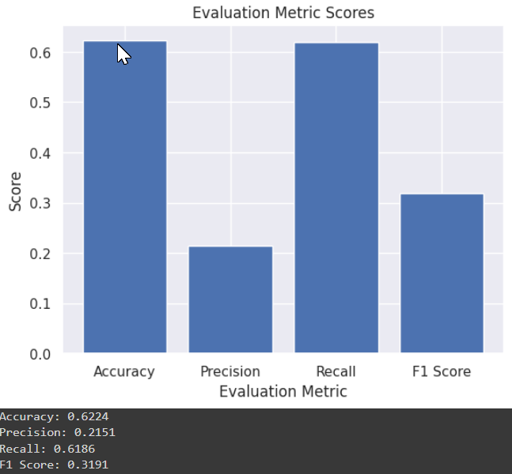
Model Building
Performance of the model before Hyperparameter tunning
Performance of the model after Hyperparameter tunning

Slide 40
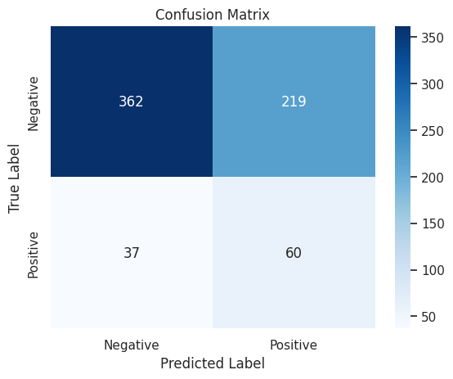
Confusion Metrics

Slide 41
Confusion Metrics
Confusion metrics are often used to evaluate the performance of a classification model. In this case, it seems that you have a confusion matrix with two classes (let's call them Class A and Class B), and the metrics are as follows:
True Positive (TP): 362
False Negative (FN): 219
False Positive (FP): 37
True Negative (TN): 60

Slide 42
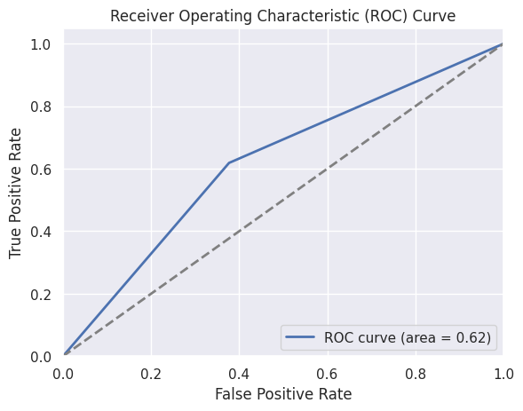
Visualizing ACU and RUC Curves

Slide 43
AUC and RUC Curves
Evaluating model performance with the ROC curve and AUC is an important step in machine learning. Understanding the trade-off between the TPR and FPR and interpreting the AUC value can help to identify areas of improvement in the model and guide future development. By considering the ROC curve and AUC, we can gain a deeper understanding of our model's performance and make better decisions in real-world applications. In this case, the AUC of 0.62 suggests that the model is performing reasonably well and may be useful in some applications.

Slide 44
Model 3 :
RandomForestClassifier
Random Forest Classifier is an ensemble learning method that builds multiple decision trees on the training dataset and combines their predictions to improve the accuracy and reduce overfitting. Each decision tree is built on a random subset of the features and the bootstrap samples of the training data. The final prediction of the Random Forest is made by majority voting or averaging of the individual tree predictions. Random Forest is a powerful and flexible model that can handle both classification and regression tasks and can provide feature importance ranking. It is widely used in various fields such as finance, healthcare, and natural language processing.

Slide 45
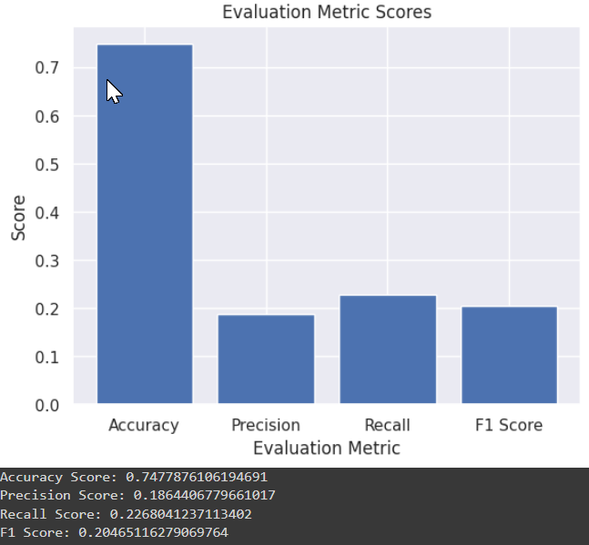
Model Building
Model performance before the hyperparameter tunning
Model performance after the hyperparameter tunning

Slide 46
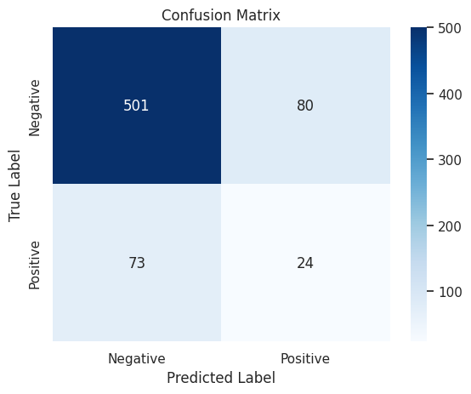
Confusion matrix

Slide 47
Confusion Metrics
Confusion matrix is an important tool for evaluating the performance of binary classification models. It allows us to visualize the number of correct and incorrect predictions made by the model. In this slide, we will examine the confusion matrix for a binary classification model with the following values:
True Positives: 501 False Positives: 80 False Negatives: 73 True Negatives: 24

Slide 48
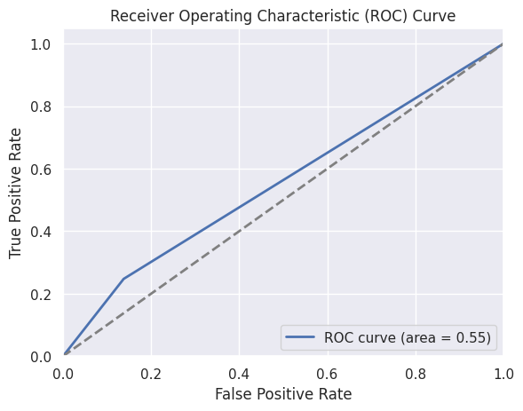
Visualization of AUC & RUC curves

Slide 49
AUC and ROC Curves
The ROC curve is a powerful tool for evaluating the performance of binary classification models. In this case, the ROC curve and AUC of 0.55 indicate that the model is not performing much better than random guessing, and may require further tuning or additional data to improve its performance. By analyzing the ROC curve and associated evaluation metrics, we can gain a better understanding of the model's strengths and weaknesses, and identify areas for improvement.

Slide 50
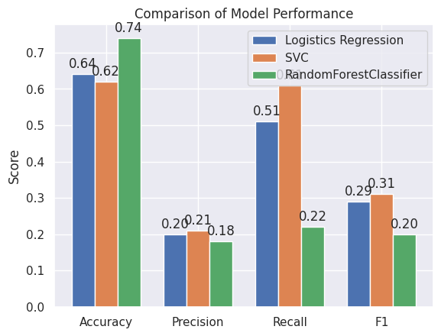
Visualizing Performance of all the Models

Slide 51
Conclusion
we can conclude the following:
LinearRegression has an accuracy of 0.643 and relatively low precision and recall values, indicating that it has a high number of false negatives and misses actual positive instances.
Support Vector Classifier (SVC) it has an accuracy of 0.622 but higher recall and F1-score values compared to Model 1, indicating that it correctly identifies more positive instances while minimizing the number of false negatives.
RandomForestClassifier has the highest accuracy of 0.748, but very low precision and recall values, indicating that it misses a significant number of actual positive instances and incorrectly classifies negative instances as positive.
The ROC curve areas for all three models are relatively low, with Support Vector Classifier (SVC) having the highest value of 0.62.
Based on the evaluation metrics and confusion matrices, Support Vector Classifier (SVC) model appears to have the most positive business impact in this case as it correctly identifies more positive instances while minimizing the number of false negatives.
In summary, the given data suggests that Support Vector Classifier (SVC) has the most favorable performance among the three models, and it would be the preferred choice for this classification task. However, the specific choice of the model would also depend on the business context and the specific goals and requirements of the classification task.

Slide 52

Thank You

